Slide 1
Student Database System
BY-
AP22110010008
AP22110010041
AP22110010048
AP22110010051

Slide 2
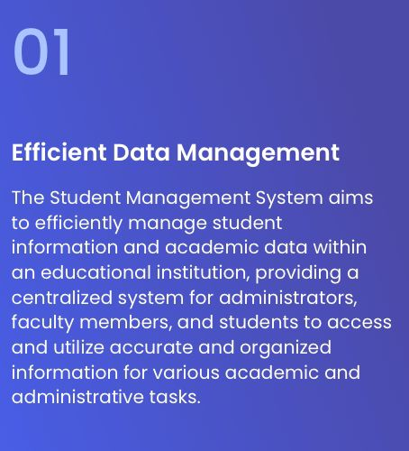
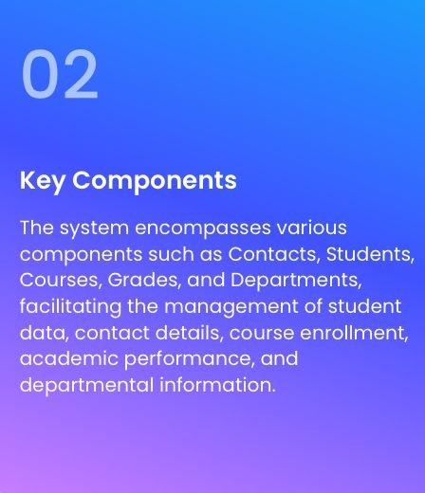
Managing Student Information

Slide 3
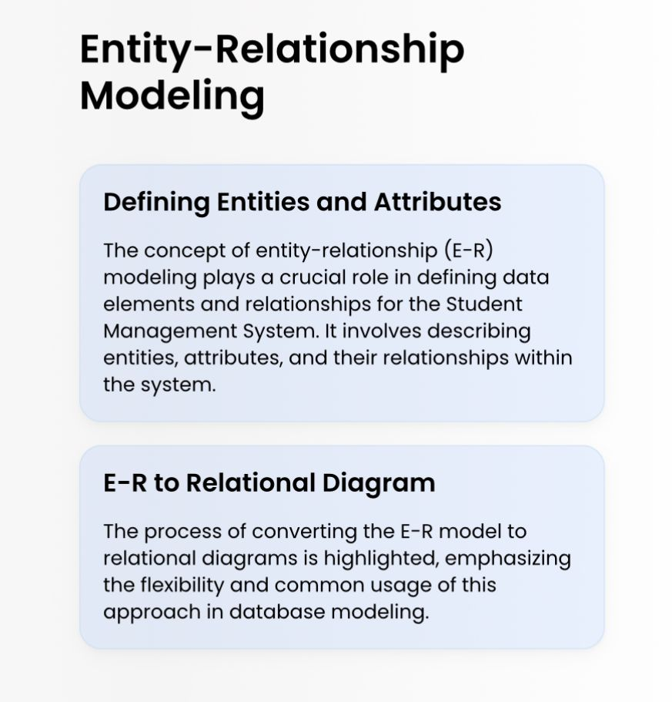
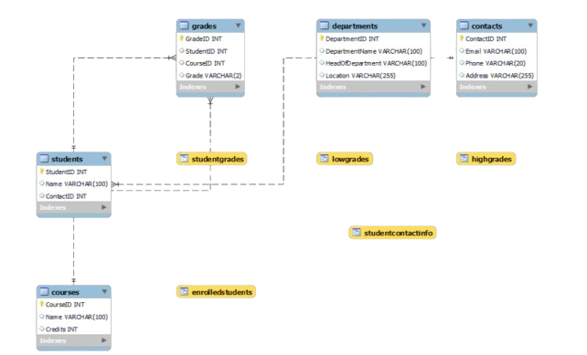

Slide 4
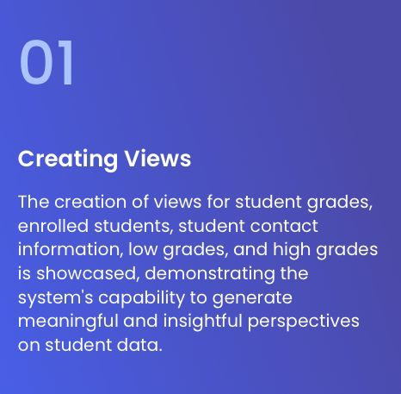
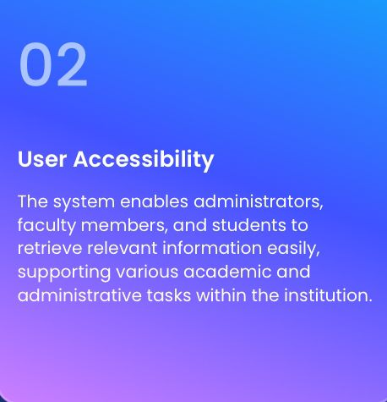
Database Views And Utililzation

Slide 5
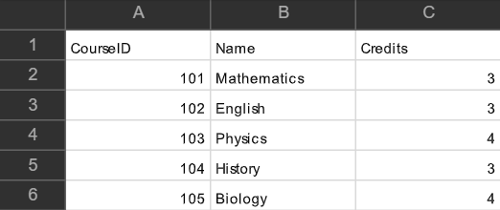
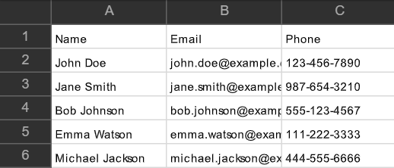
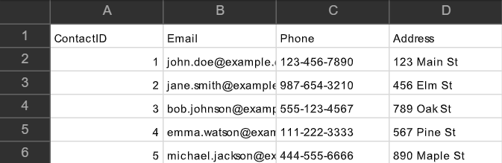
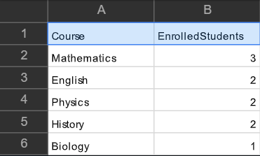
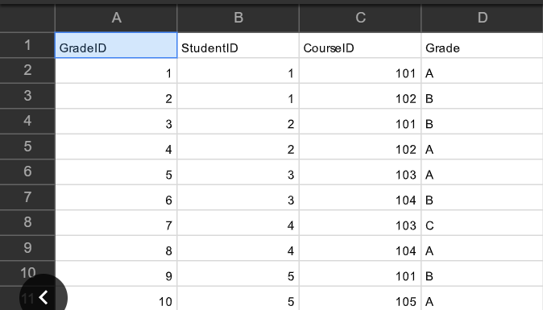
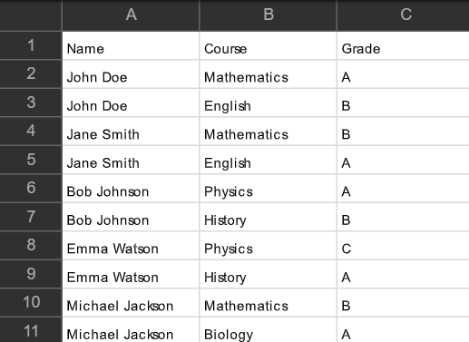
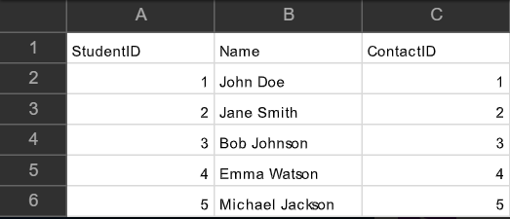
CREATE DATABASE student;
USE student;
CREATE TABLE Contacts (
ContactID INT PRIMARY KEY,
Email VARCHAR(100),
Phone VARCHAR(20),
Address VARCHAR(255)
);
CREATE TABLE Students (
StudentID INT PRIMARY KEY,
Name VARCHAR(100),
ContactID INT,
FOREIGN KEY (ContactID) REFERENCES Contacts(ContactID)
);
CREATE TABLE Courses (
CourseID INT PRIMARY KEY,
Name VARCHAR(100),
Credits INT
);
CREATE TABLE Grades (
GradeID INT PRIMARY KEY,
StudentID INT,
CourseID INT,
Grade VARCHAR(2),
FOREIGN KEY (StudentID) REFERENCES Students(StudentID),
FOREIGN KEY (CourseID) REFERENCES Courses(CourseID)
);
CREATE TABLE Departments (
DepartmentID INT PRIMARY KEY AUTO_INCREMENT,
DepartmentName VARCHAR(100) UNIQUE,
HeadOfDepartment VARCHAR(100),
Location VARCHAR(255)
);
Tables in the database

Slide 6
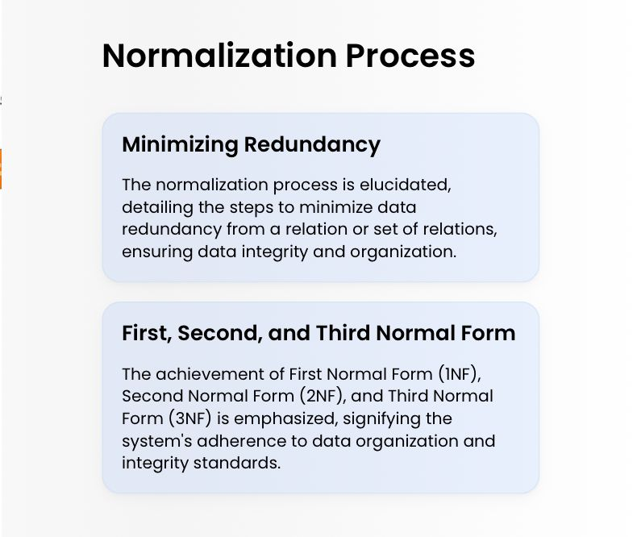

Slide 7
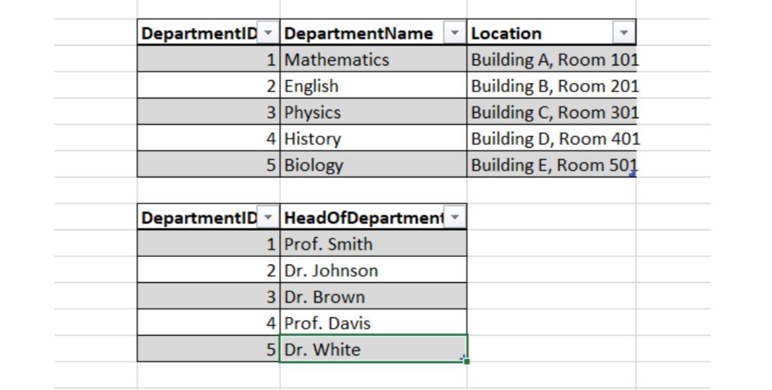
Normalised Database structure

Slide 8
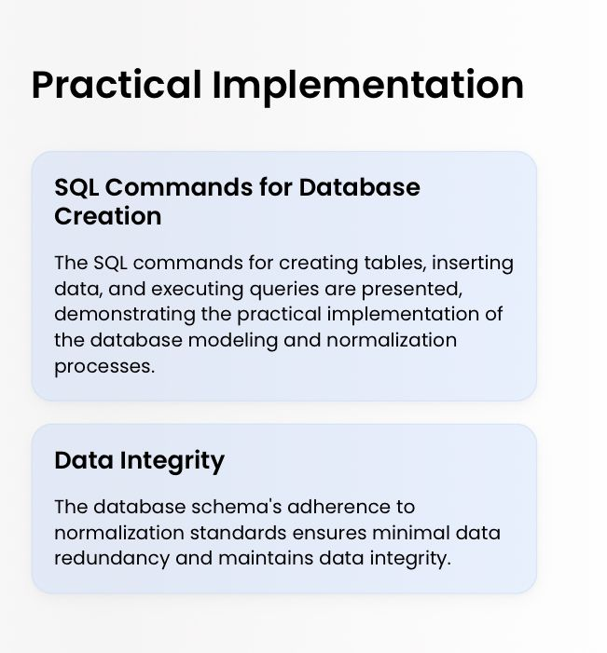
CREATE VIEW StudentGrades AS
SELECT Students.Name, Courses.Name AS Course, Grades.Grade
FROM Students
JOIN Grades ON Students.StudentID = Grades.StudentID
JOIN Courses ON Grades.CourseID = Courses.CourseID;
CREATE VIEW EnrolledStudents AS
SELECT Courses.Name AS Course, COUNT(*) AS EnrolledStudents
FROM Courses
JOIN Grades ON Courses.CourseID = Grades.CourseID
GROUP BY Courses.Name;
CREATE VIEW StudentContactInfo AS
SELECT Students.Name, Contacts.Email, Contacts.Phone
FROM Students
JOIN Contacts ON Students.ContactID = Contacts.ContactID;
CREATE VIEW HighGrades AS
SELECT Students.Name, Courses.Name AS Course, Grades.Grade
FROM Students
JOIN Grades ON Students.StudentID = Grades.StudentID
JOIN Courses ON Grades.CourseID = Courses.CourseID
WHERE Grades.Grade IN ('A', 'A+');
CREATE VIEW LowGrades AS
SELECT Students.Name, Courses.Name AS Course, Grades.Grade
FROM Students
JOIN Grades ON Students.StudentID = Grades.StudentID
JOIN Courses ON Grades.CourseID = Courses.CourseID
WHERE Grades.Grade IN ('D', 'F');
SHOW TABLES;

Slide 9
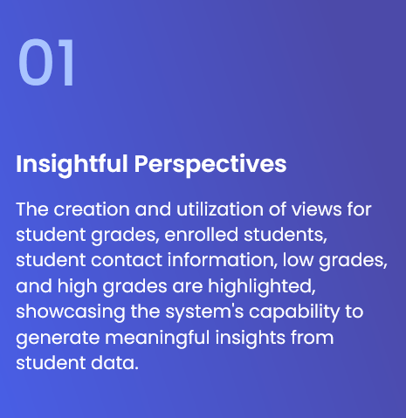

Utilizing Database Views

Slide 10
Data Integrity and Security
Ensuring Data Integrity
The database schema's adherence to normalization standards
ensures data integrity and minimizes data redundancy,
providing a reliable and secure platform for managing student information.
Security Measures
The system incorporates security measures to safeguard
student data and ensure compliance with data protection regulations.

Slide 11
Conclusion
In conclusion, the Student Database Management System utilizing MySQL offers a
robust solution for educational institutions to efficiently manage student information.
By leveraging MySQL's capabilities, the system ensures data integrity, scalability, and security.
With features such as student enrollment, course management, and performance tracking, it empowers administrators,
educators, and students alike. As technology continues to evolve,
this system stands as a testament to the power of database management in enhancing the educational experience.

Slide 12
Thank
you

